Slide 2
intro

Slide 3
Implementation
Python with concurrency optimization
GIL – global interpreter lock
Processes instead of threads - Multiprocessing
Lots of data transfer on windows – no time saving
Linux copy on write

Slide 4
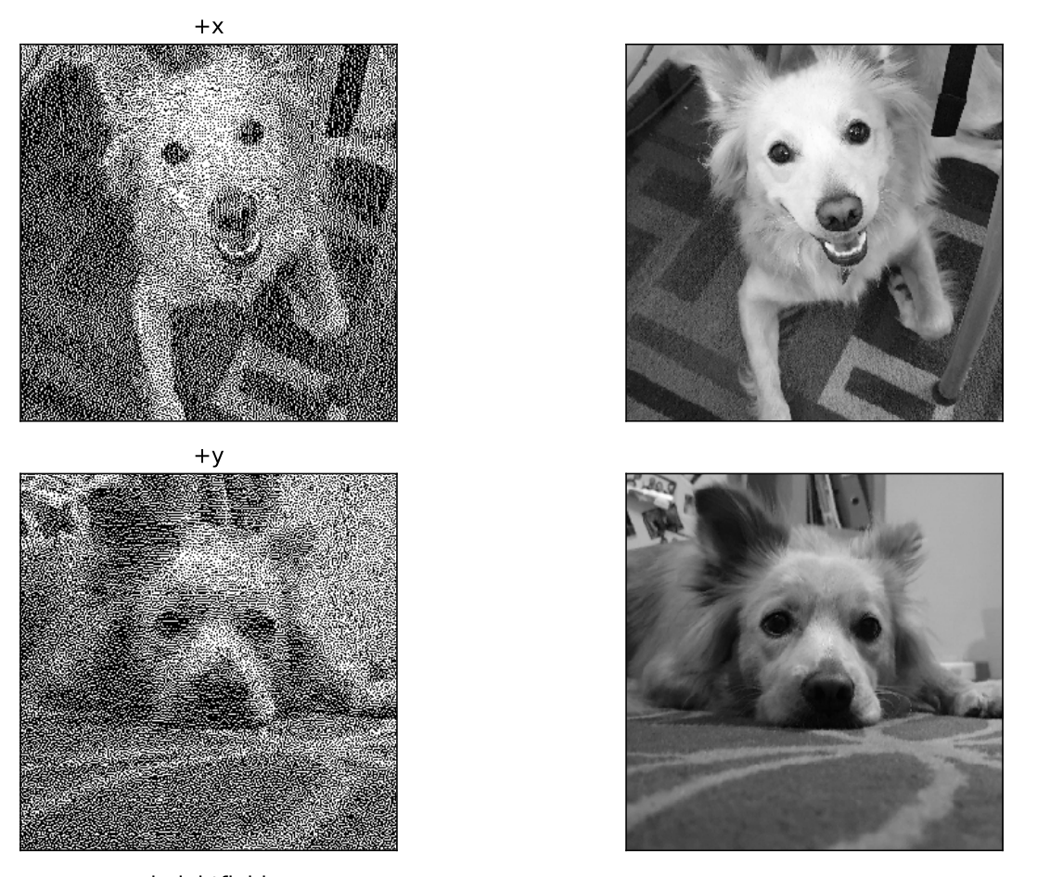
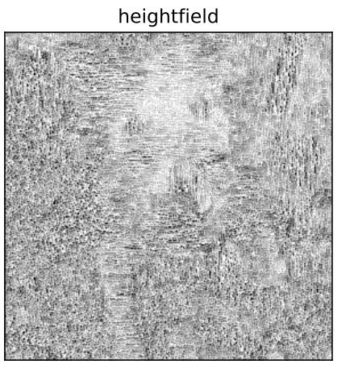
Results

Slide 5
Results
Rick and morty

Slide 6
Results
Albums

